Slide 1
Python Tools for Starting Machine Learning Research
Chengcheng Li, PhD
School of IT
University of Cincinnati
June 21, 2019

Slide 2
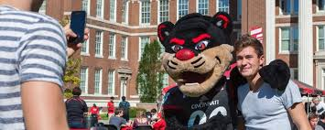
Welcome to University of Cincinnati!

Slide 3
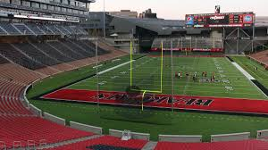
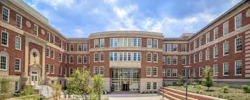
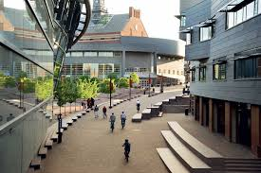
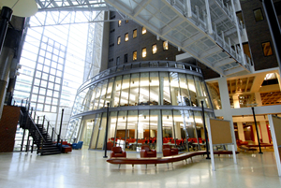
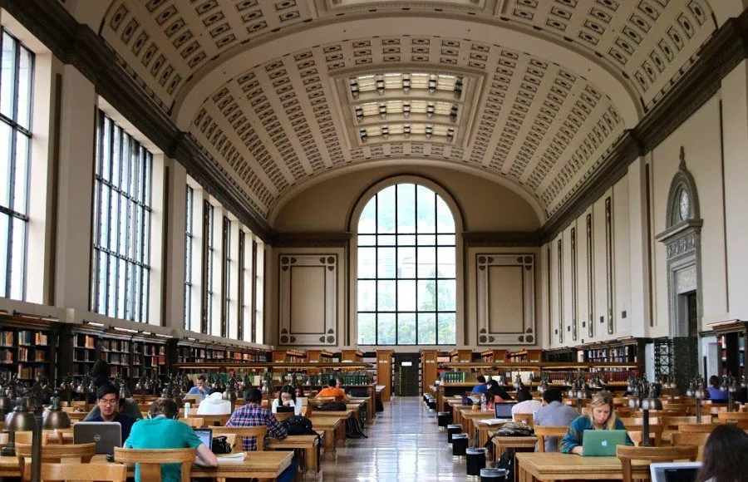
Welcome to University of Cincinnati!

Slide 4
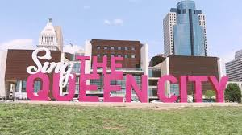
Welcome to University of Cincinnati!

Slide 5








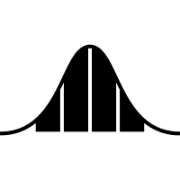


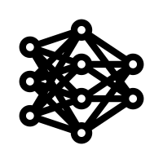

Lecture Milestones
Background
Data Science
Languages
Development
Data Science
Python
Q4
Machine Learning
Frameworks
APIs
Web Scraping
Data Processing
Q4
Q3
Q2
Q1
Scikit- Learn
Visualization
Statistics and Math
ML Models
Train the Model
Hands-On Projects
Q1
Q2
Q3
Q4
Preprocessing
Model Evaluation

Slide 6

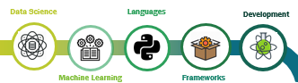
Background

Slide 7

Data Science
Science of extracting information from data, creating new knowledge

Slide 8
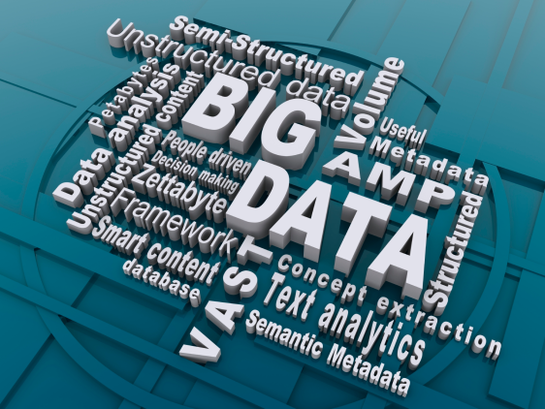
Data
"Every two days we create as much information as we did from the dawn of civilization up until 2003".
- Eric Schmidt, Google CEO
Source: Quadix.com

Slide 9
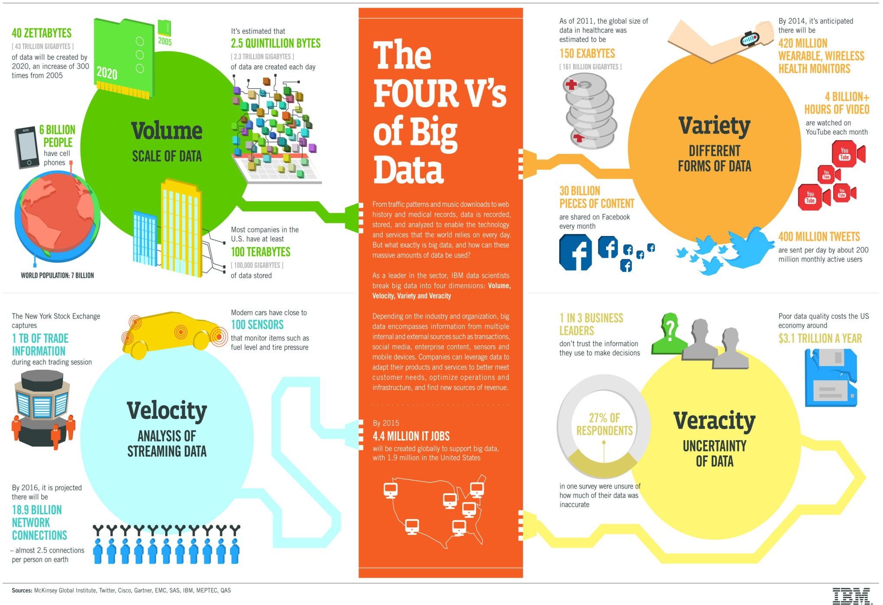
The 4Vs of Big Data
Source: http://www.ibmbigdatahub.com/

Slide 10
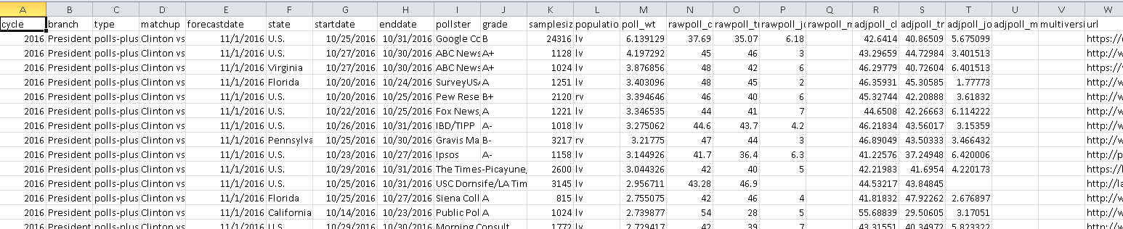
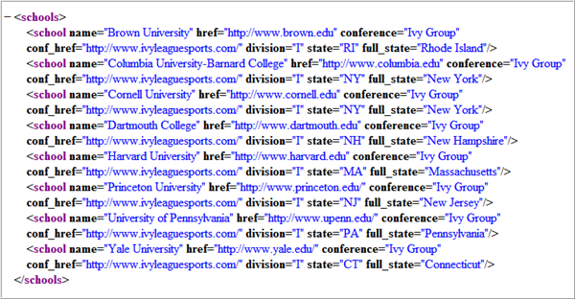
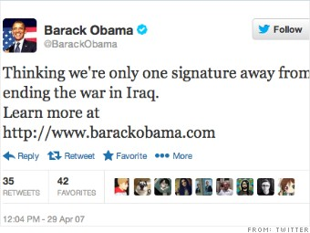
Data
Data Sources

Slide 11
The 4Vs of Big Data
Source: http://www.ibmbigdatahub.com/

Slide 12
Applications of Data Science
Describe/present
Data visualization – an emerging research field
Data visualization summit – VIS2019
National Science Foundation - Projects Challenge

Slide 13
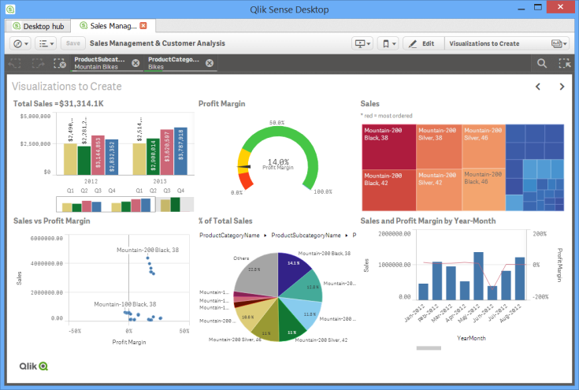
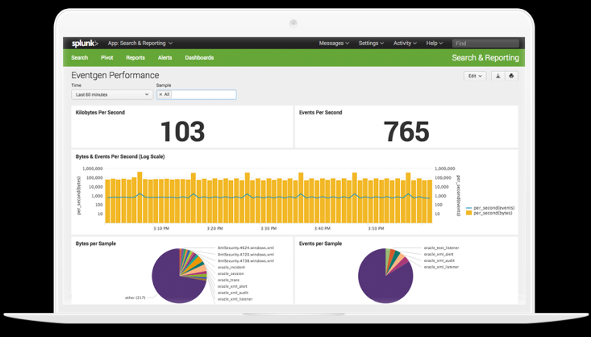
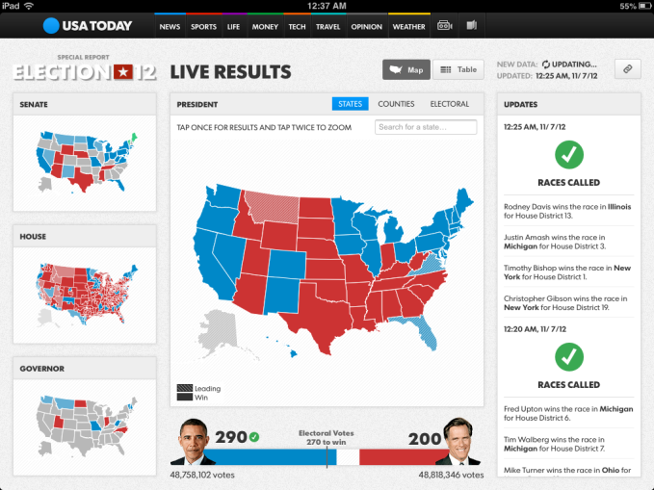
Applications of Data Science
Describe/present
Big data /un- and semi-structured data
Data visualization – an emerging research field
Data visualization summit – Summit 2017 San Francisco
National Science Foundation - Projects Challenge
Tools – Tableau, Splunk, D3js, Google Chart
Example
Source: BBVAopen4u.com
Source: splunk.com
Source: mapbox.com

Slide 14
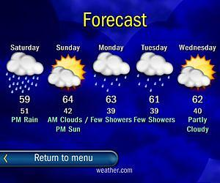
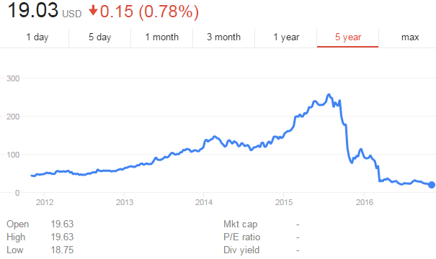

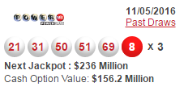
Applications of Data Science
Predict
Source: www.npo.io

Slide 15
Applications of Data Science
Cluster
Find hidden meaning: associations
Decision Making
…
“With estimated 1,685,210 new cases of cancer to be diagnosed in the U.S. in 2016 and over 35 percent of them to be lethal, even increasing survival rate by one percent converts to 16,852 lives saved annually.
A Boston healthcare startup, BERG Health, reshapes the cancer medication market through extensive use of data science. Using powerful machine learning algorithms the company extracted and analyzed biological samples from over 1,000 patients. With over 14 trillion data points contained in each sample, that was a plenty of information to feed into the AI algorithm.
As a result, the company developed BPM 31510, the drug, which detects and triggers the natural death of cells damaged by the disease. Thus, the cancer cells can be removed from the human body naturally, without extensive medication and further damage to the patient’s health.”
-https://www.altexsoft.com/blog/datascience/7-ways-data-science-is-reshaping-healthcare/

Slide 16
Future of AI
The number of transistors per square inch on integrated circuits had doubled every year since their invention - Moore’s Law
The singularity is the hypothesis that the invention of artificial superintelligence will abruptly trigger runaway technological growth, resulting in unfathomable changes to human civilization – Singularity

Slide 17



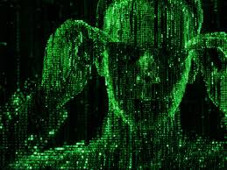
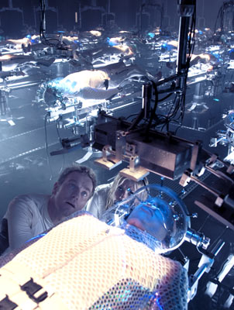
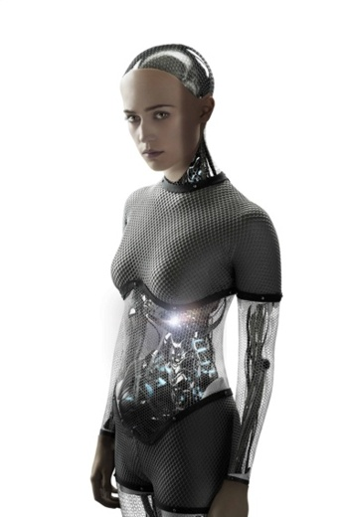
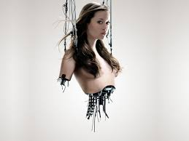
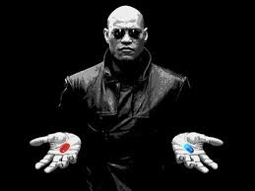
Future of Healthcare
Source: 123rf.com

Slide 18
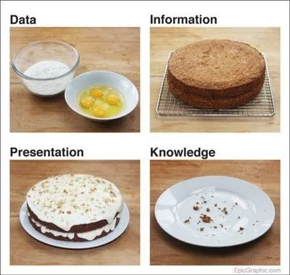
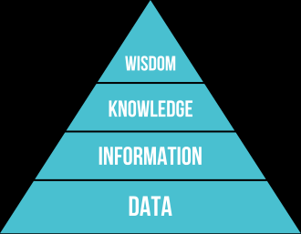
DIKW Model
DIKW
Source: Wikipedia.org
Source: EpicGraphic.com

Slide 19
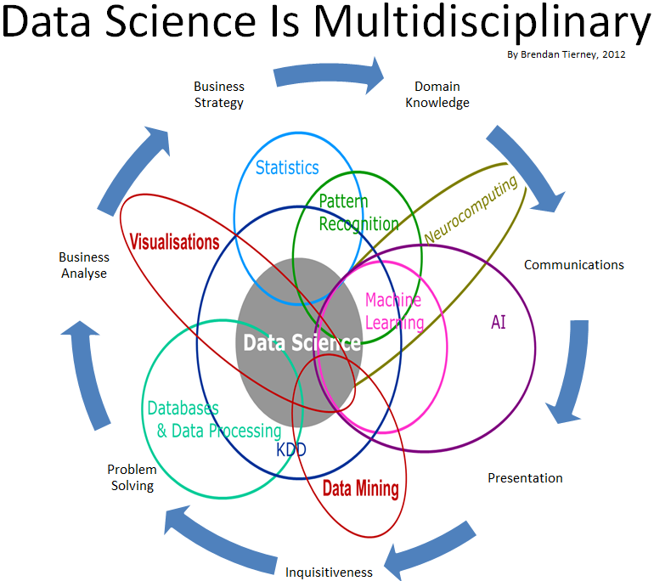
Source: http://www.oralytics.com/2012/06/data-science-is-multidisciplinary.html

Slide 20
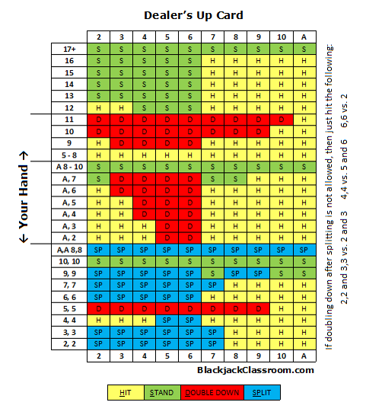

Simple Card Game

Slide 21
What skills DS needs
Know your data
Problem solving skills
Statistics
Machine learning
Hacking skills
Presentation skills

Slide 22
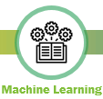
Machine Learning
“A computer program is said to learn from experience E with respect to some class of tasks T and performance measure P if its performance at tasks in T, as measured by P, improves with experience E."
- Tom M. Mitchell

Slide 23
Machine Learning
Supervised, unsupervised, and reinforcement learning
Predict, cluster/classify, make decisions (blackjack, driving racing car, playing golf..)
Example: Spam filter evolvement
Machine Learning Algorithm Mines 16 Billion E-Mails
https://www.technologyreview.com/s/536586/machine-learning-algorithm-mines-16-billion-e-mails/

Slide 24

Target Case
How Target Figured Out A Teen Girl Was Pregnant Before Her Father Did

Slide 25
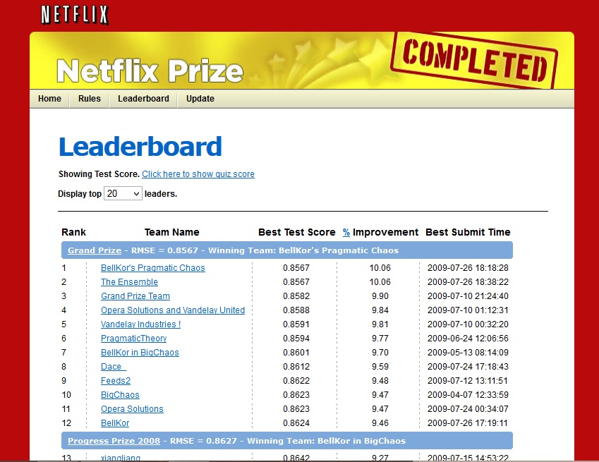
Netflix Prize
Netflix Prize
Kaggle.com

Slide 26
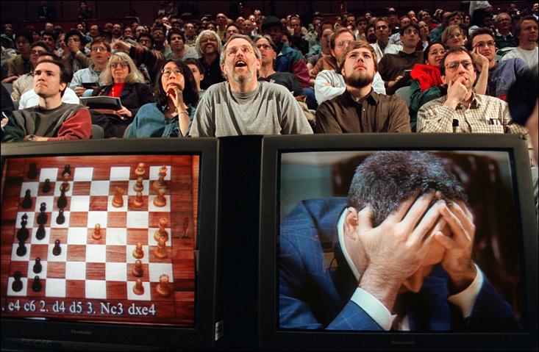
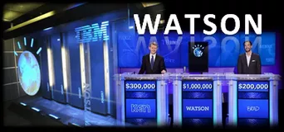
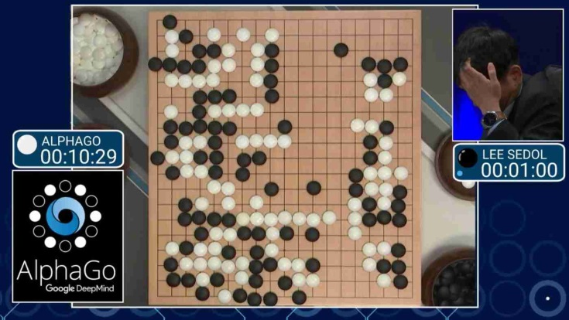
Major AI Milestone
IBM Deep Blue (chess)
IBM Watson (Jeopardy)
Google Deepmind AlphaGo (Go)

Slide 27
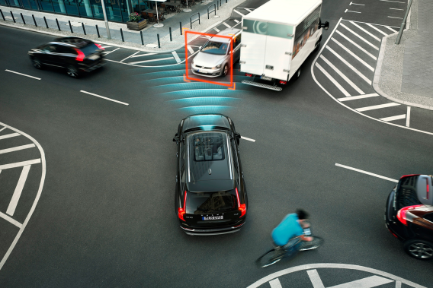
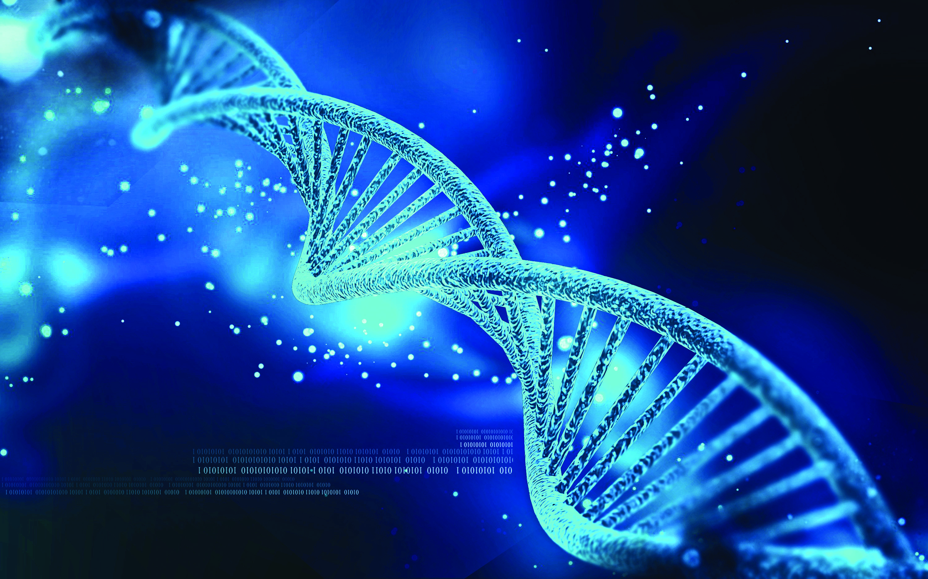
Major AI Milestone
Self Driving Car
Genomics Research

Slide 28


Machine Learning Languages
C++ Java Javascript Matlab/Octave
Python vs. R
Survey major 2019 Machine Learning courses
Udemy, Udaciy, Coursera, Edx
Survey major 2019 Githut projects
Survey Result

Slide 29

Python Packages and Libraries
Math and Scientific Computing
Numpy, Scipy
Data Visualization
Matplotlib, Seaborn
Data Processing/manipulation
Pandas
Web Scraping
Beautiful Soup 4, lxml, Scrapy
Web Services APIs
python-twitter, pytrends
Network Tasks Automation

Slide 30
Python Machine Learning Frameworks
Classic Machine Learning
Scikit-Learn
Deep Learning
Theano /Caffe2
Tensorflow
Pytorch
Keras
Tflearn
References: Deep Learning Frameworks Compared 3-minute video
Deep Learning Frameworks 2019 updated version 13 minutes
Notes:
Sklearn: Classic machine learning algorithms. Scikits are additional packages of SciPy Stack designed for specific functionalities like image processing and machine learning facilitation. In the regard of the latter, one of the most prominent of these packages is scikit-learn. The package is built on the top of SciPy and makes heavy use of its math operations.
The scikit-learn exposes a concise and consistent interface to the common machine learning algorithms, making it simple to bring ML into production systems. The library combines quality code and good documentation, ease of use and high performance and is de-facto industry standard for machine learning with Python.

Slide 31


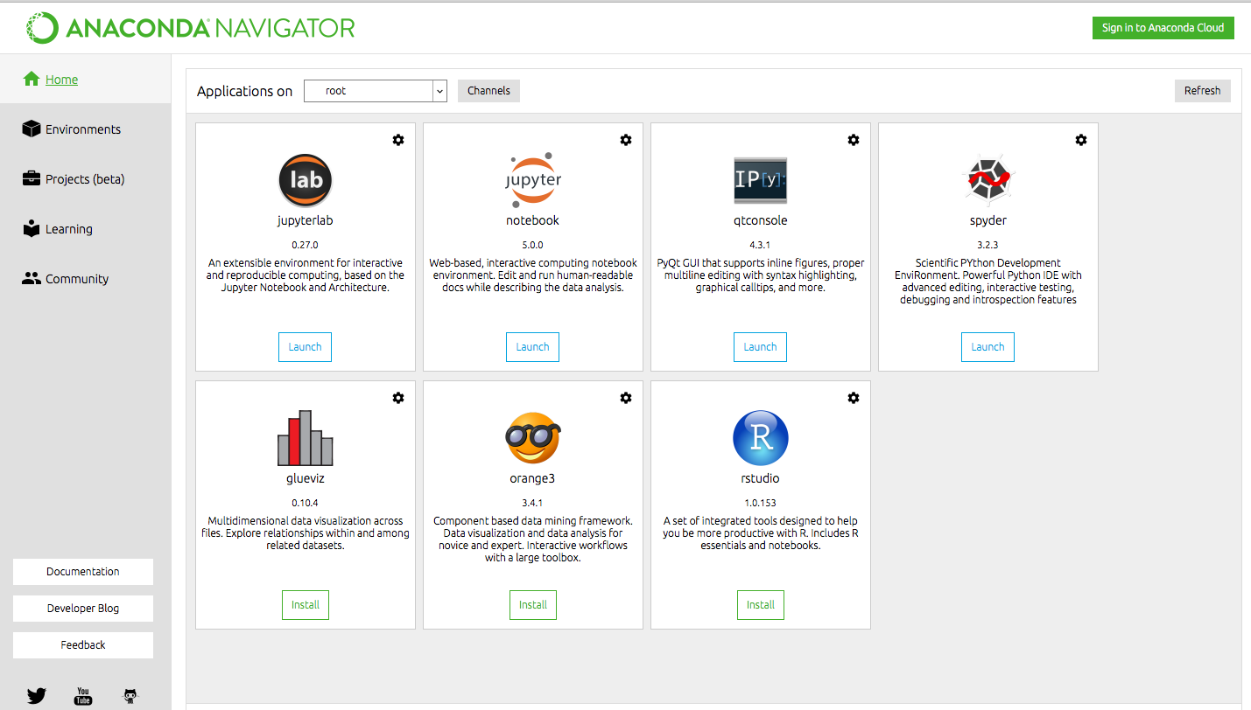
Integrated Development Environment
Create your own development environment
Ubuntu
Anaconda (bash ~/.sh) or
Pip Install (python package management)
Anaconda
IDE and Tools
Use environments
Conda create –n myenv
Conda install –n myenv packages
Source activate myenv
Python3.6 for tensorflow
Enable GPU computation
Google Colab (hands-on)

Slide 32

N
O
H
A
N
D
O
N

Slide 33
Summary

Slide 34
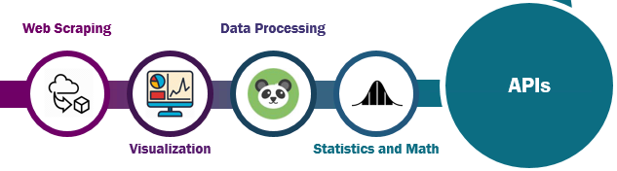
API

Slide 35
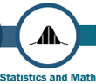
Statistics and Scientific Libraries
Quick Python Intro
Variables: int, float, bool (True, False), str
Special variables
List: ordered sequence [1, “1”, True, 3, 4]
Tuple: immutable sequence (1, “1”, True, 3, 4)
Dictionary: key-value pairs {“Tom”: “A”, “Jack”: “C”, “Jane”: 89}
For loop
[expression for expr in sequence if condition]
[x**2 for x in range(2,20,2) if x%3==2 ] → [4, 64, 196]
➔ [4, 16, 36, 64, 100, 144, 196, 256, 324]
Function, class definition
File IO
List operations aList[n:m], aList[n:], aList[:m], sort(), append(), pop(), insert(), remove(), len()
Notebook 1 – Intro_to_notebook_and_python.ipynb

Slide 36
Statistics and Scientific Libraries
Numpy (https://www.numpy.org/ )
NumPy is the fundamental package for scientific computing with Python. It contains among other things:
a powerful N-dimensional array object
sophisticated (broadcasting) functions
tools for integrating C/C++ and Fortran code
useful linear algebra, Fourier transform, and random number capabilities
Arrays
key basic elements of scientific computing
Tensors: generalized vector represented as multidimensional arrays
Why do we need arrays while we have Python lists?
Efficient Operation
Smaller storage and faster computation due to vectorization
Uniformed data type in array
Notebook 2 – Numpy.ipynb

Slide 37
Statistics and Scientific Libraries
Scipy Library
Numerical routines
Statistics functions
Generate random data on certain statistical distributions
Linear algebra
Scipy Eco-system (https://www.scipy.org)
Notebook 3 – Scipy.ipynb

Slide 38
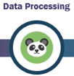
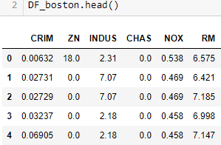
Data Pre-processing and Manipulation Libraries
Pandas
Data Manipulation and Analysis
Load data from file, database, webpages…
Indexing
Treat missing data
Dataframe
SQL like operations: join, regroup, merge
Notebook

Slide 39

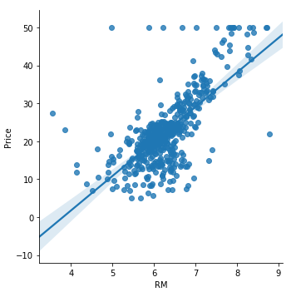
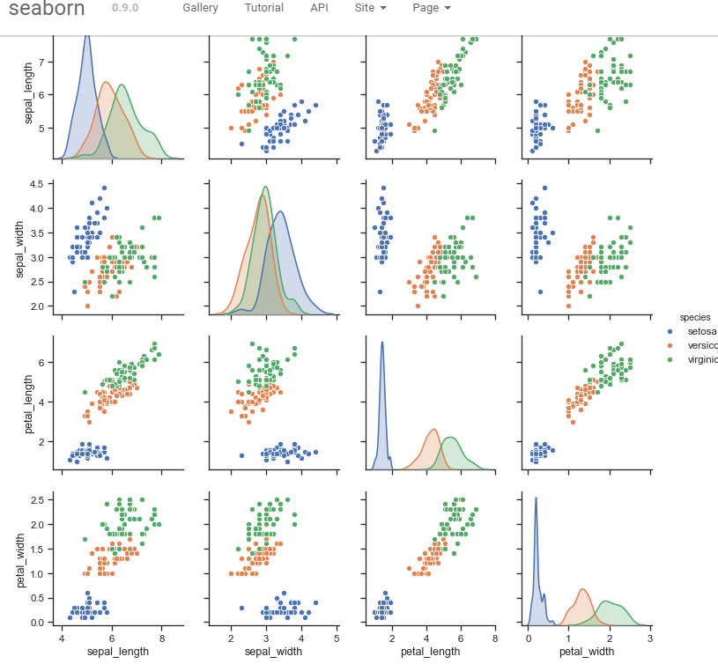
Data Visualization Libraries
Matplotlib
Charting
Visualization
Seaborn
Statistical visualization
Notebook 1 – Intro_to_notebook_and_python.ipynb

Slide 40

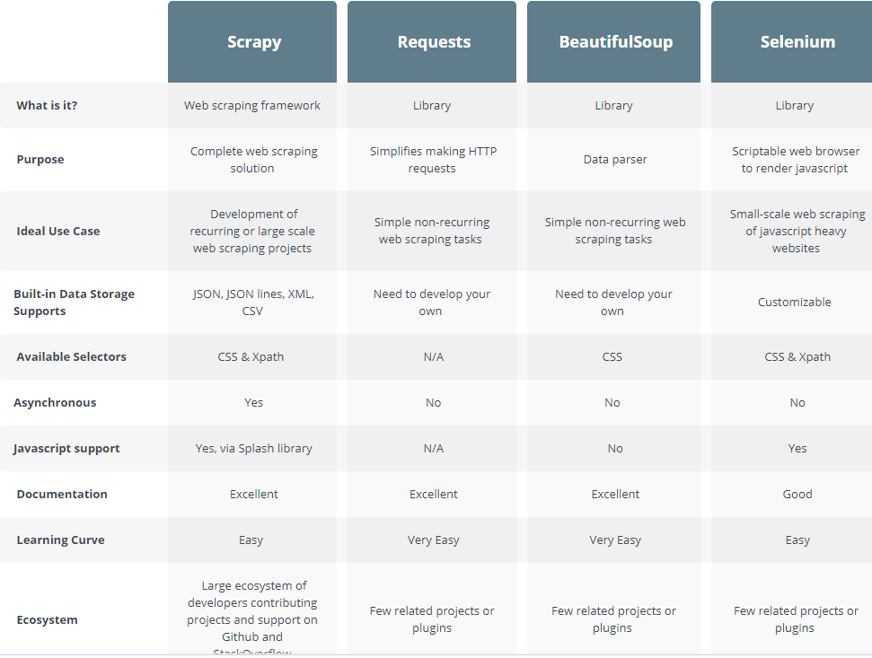
Web Scraping (crawler) Libraries
Scrapy
Requets, Selenium, BeatifulSoup
Parse and extract HTML or XML and render JS codes
https://info.scrapinghub.com

Slide 41
Python Tools for Starting Machine Learning Research - Part 2
Chengcheng Li, PhD
School of IT
University of Cincinnati
June 24st , 2019

Slide 42
Machine Learning
“A computer program is said to learn from experience E with respect to some class of tasks T and performance measure P if its performance at tasks in T, as measured by P, improves with experience E."
- Tom M. Mitchell
How to define an environment or experience?
What to learn?
Why do we need machine to learn?
What are the tasks?
Why do we have to measure the performance?
Notes:
Interact with E (data), a digital world
Learn? - figure out a rule, a strategy, a model, a mathematical model (usually based on statistics)
Machine? – minimum human programming, it’s an autonomous process (not rule-based, computer will figure out the rule, no “ifs”)
Tasks? Simulate human actions
P? all we want, a better intelligent solution, a smarter decision, a new or improved view of the world.

Slide 43
Supervised Learning
Training Data (X_train, y)
Initiate a model f(X)
f(X_train) → y_predict
Errors E(y_predict, y)
Update f(X)
Prediction vs. Classification
Depending on property of y

Slide 44
Supervised Learning Algorithms
Linear Regression
Logistic Regression
Support Vector Machines
K-nearest Neighbor
Naïve Bayes
Decision Tree
Random Forest Tree
Neural Network (Deep Learning)

Slide 45
Practice
Bias-variance tradeoff
Simple vs. complex models
Training errors vs. testing errors
Cost of acquiring data and computation complexity
Choose the right amount of training data
Choose the right percentage of training data
Split data into training, validation, and testing
Save data through cross validation
Correlations of features and feature dimensionality
Dimension reduction – tradeoff between computation complexity and performance
Understand the performance
Accuracy
Type I, II errors
Confusion matrix
Need a tool to cover all the above concern
Python Scikit Learn

Slide 46
Scikit-learn
Introduction
Built on Numpy, SciPy, Matplotlib
Blackbox approach: user-friendly APIs to quickly perform data mining tasks without much programming
Machine learning algorithms
Other essential data processing functions
Preprocessing, feature extraction
Dimension reduction
Parameter search and model selection
Limitation
GPU
Deep learning

Slide 47
Scikit-learn: Basic Steps
1. Load and clean dataset
2. Split data into X_train, X_test, y_train, y_test
3. Create a machine learning model
from sklearn import neighbors
model = neighbors.KNeighborsClassifier(n_neighbors=3)
4. Train the model using .fit(X_train, y_train)
5. Predict using .predict(X_test)
6. Model evaluation
.score(y_train, y_test) # accuracy
.report # metrics report
.confusion # confusion matrix

Slide 48
Algorithms
Linear Regression Let’s Revisit Notebook 1
Notebook 5

Slide 49
Get Hands Dirty
6_Sklearn_machine_learning.ipynb
A quick test run on a small dataset
Understand Scikit-learn user manual and examples

Slide 50
Tensorflow
Introduction/background

Slide 51
Tensorflow – A high level approach
Keras vs Tflearn
Keras learning steps
Build model
Compile model
Train the model
Model evaluation

Slide 52
Convolution Neural Network
CNN Introduction - https://stanford.edu/~shervine/teaching/cs-230/cheatsheet-convolutional-neural-networks
Image – size/data
Convolutions – filters
Pooling
Fully Connected Network
Dropout rate
Stride/padding
Activation functions
Softmax
Normalization

Slide 53
Quick Example
One-layer fully connected network Softmax
ANN
See how easy to create a deeplearning network using Keras
Add Convolution Layer
Add Maxpooling
Add Normalization
Alexnet
Notebook 7

Slide 54
Other Considerations
Performance Evaluation
Image Augmentation
Stop iterations based on predefined criteria
Save and restore model for retraining
Other implementations in supervised, unsupervised and reinforcement learning
Recursive Neural Network
Long short-term memory (LSTM)
Autoencoder
Generative Adversarial Networks (GAN) ; Q-learning
RL-GAN-Net

